Slide 1

Properties of Boolean functions in Cognitive
Complexity Measure
Gabriel Shafat, Prof. Ilya Levin
School of Education, Tel Aviv University
The 2nd Prague Embedded Systems Workshop

Slide 2
Outline
Motivation. Cognition vs. Pragmatics
Boolean concepts learning
Math complexity vs. Cognitive Complexity
Feldman’s complexity and it’s criticism
Our study:
  Recognition
  Reconstruction
  Fault Identification
Conclusion
Future Work

Slide 3
Motivation. Cognition vs. Pragmatics
Engineering education is a baby of the Industrial Society,
which was production oriented and pragmatic
The Digital Society is the society of services. It becomes
more personalized. Personal fabrication, personal environment,
context awareness, etc. become ubiquitous.
In the Industrial Society, the curriculum was in the focus.
Learning was a secondary phenomenon
In the Digital Society, the learning becomes dominating.
The ability to learn is in the focus of education

Slide 4
Human Concepts Learning
  Understanding Concepts by Humans
  Boolean Concepts Learning. History:
    NPN classes of the equal complexity
    (Shepard, Hovland and Jenkins, 1961)
    AND-OR non-symmetry (Nosovsky, 1962)
    Complexity - the number of literals in the minimal
    Boolean expression (Feldman, 2000)

Slide 5
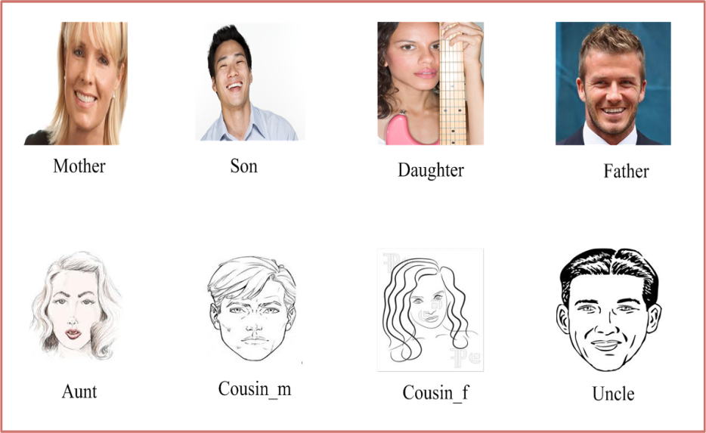
Boolean concepts
x-children “0”, parents “1”
y-male “0”, female “1”
z-family “0”, kin “1”

Slide 6








Boolean concepts
000
100
001
101
010
110
011
111

Slide 7
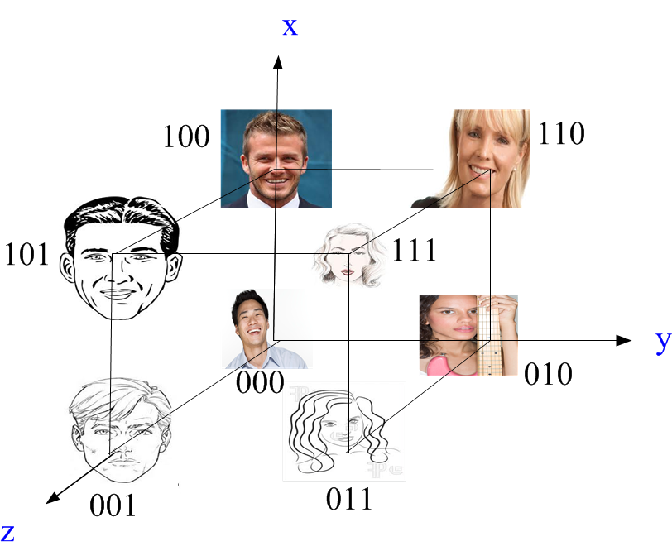
Boolean cube

Slide 8



Boolean concepts
x-shape
y-size
z-color

Slide 9
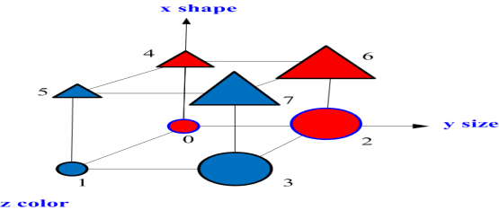








Boolean concepts
100
101
110
111
000
001
010
011
8 binary
combinations
Graphical
representation

Slide 10
Mathematical Complexity
  Information complexity – Shannon
  Almost all functions are hard, but we don’t have any bad
  examples
  Algorithmic complexity - Kolmogorov
  Complexity of algorithm producing Boolean Concept

Slide 11
Cognitive complexity of Boolean Concepts
These types of Boolean concepts have been studied extensively by Shepard, Hovland, and Jenkins-SHJ (1961), (Nosofsky, Gluck Palmeri, McKinley, and Glauthier 1994).
These studies focused on Boolean concepts with three binary variables, where the concept receives “1” for 4 out of 8 possible combinations and “0” for the remaining 4 combinations.
There are 70 possible concepts

Slide 12
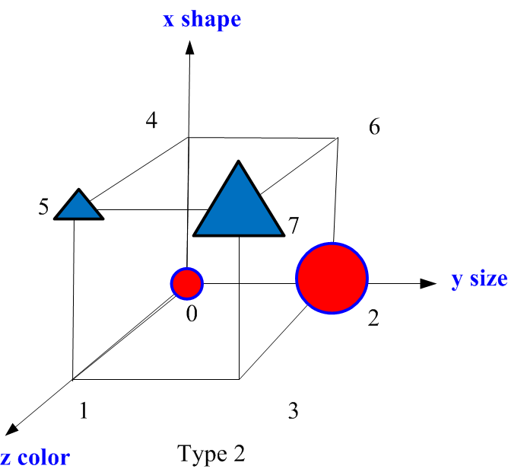
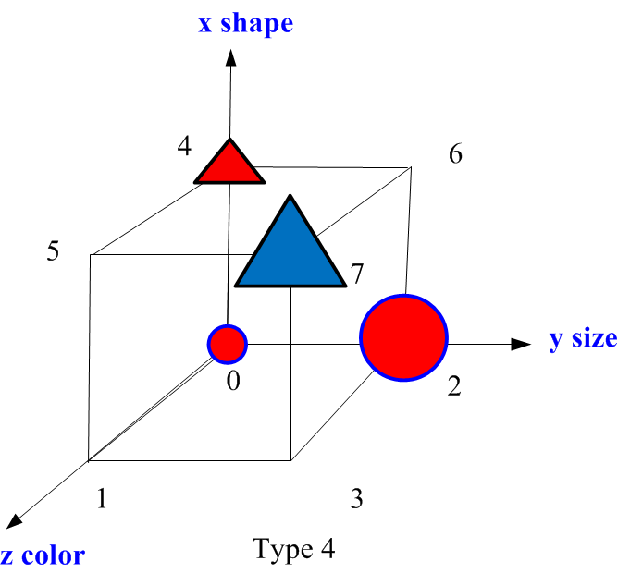

Slide 13
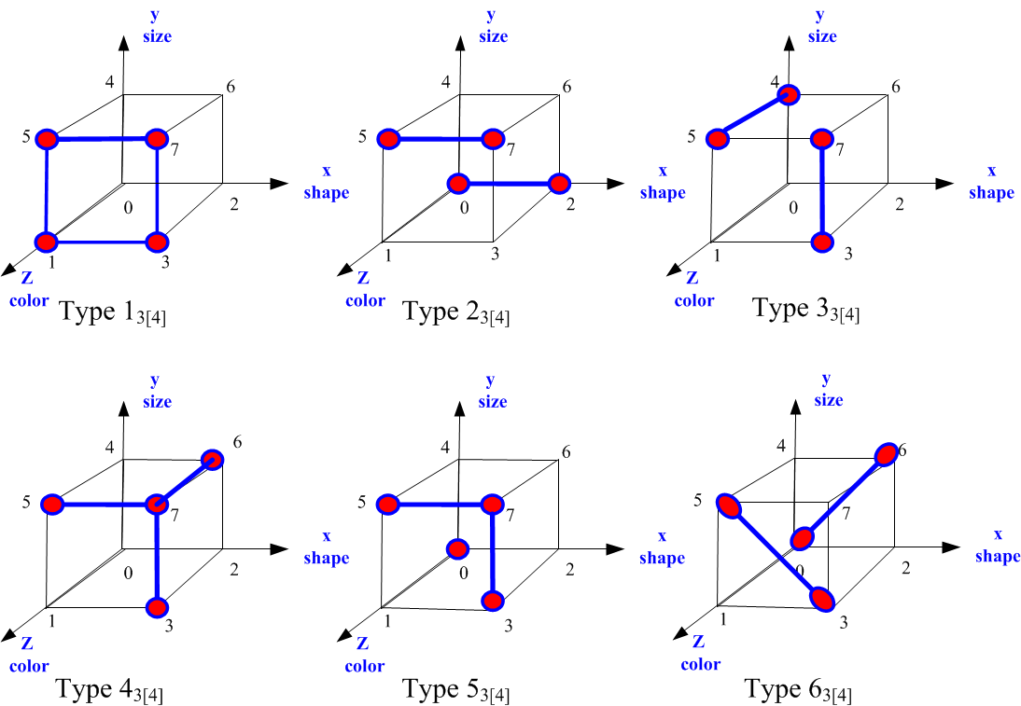
Difficulty of Boolean concept learning
Since some of the 70 possible Boolean concepts are congruent, (NPN) they can be categorized as the same type into six subcategories.
The six subcategories with structural equivalence can be described in a geometrical representation using cubes
SHJ types graphed in Boolean space

Slide 14
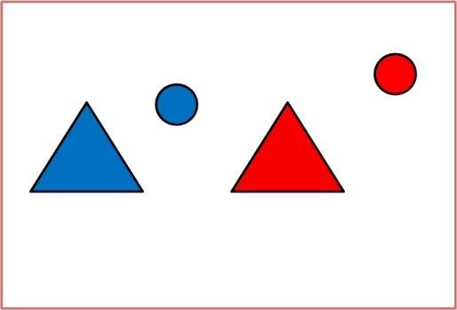
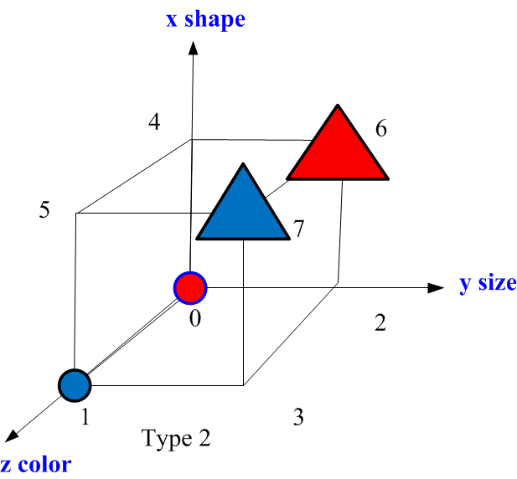

Slide 15
What is more complex for humans?

Slide 16
The result of this study are highly influential since Shepard at all proposed two informal hypotheses
The number of literals in the minimal expression predicts the concept’s level of difficulty
Ranking the difficulty among the concepts in each type depends on the number of binary variables in the concept

Slide 17
Feldman (2000), Nature
  Minimal Boolean complexity
    Length of the shortest logical expression that captures the concept
  I < II < III, IV, V, < VI
  1 4 6 6 6 10
Type1 are the simplest to learn and the subgroup of concepts belonging to Type6 are the most difficult, according to the following order:
Type 1<Type2<(Type3=Type4=Type5)<Type6

Slide 18
Drawbacks of Feldman’s complexity
  1. Not minimal! (Vigo, 2006)
    Corrected: I < II, III < IV < V< VI
    1 4 4 5 6 10
  2. Ad-hoc choice of operators. Include "xor":
    I < II < V, VI < III < IV 1 2 3 3 4 5
    No psychological mechanism for forming minimal descriptions

Slide 19
Feldman’s Complexity Issues
  Problem of Boolean minimization (Vigo, 2003)
  Feldman’s heuristics failed to find the correct minimal descriptions
  for certain concepts. People cannot really minimize
  Problems of basis
    To justify the set of primitive connectives that are allowed in
    formulating descriptions. A standard defines of not, and, and or,
    is that they have been conventional since the work of Neisser and Weene
    (1962). But, why should we exclude XOR?
  Problems of functional properties
  Individuals can carry out the task of categorizing instances of a
  concept without attempting to formulate its minimal description.
  Simple example: symmetric functions

Slide 20
Feldman’s Complexity Issues
  Boolean Approximation problems
  People usually approximate their solutions
  Representation problems
  Cubes, sets, diagrams, cards, BDDs etc.
  Different tasks problems
    Whether the approach works for different types of tasks:
    Recognition, Reconstruction, Fault Identification
  Nonstandard solutions problems
    To justify the set of operators allowed in formulating descriptions

Slide 21
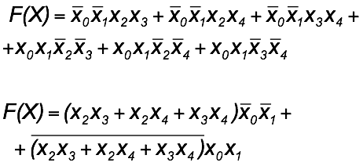
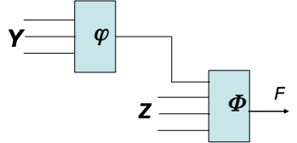
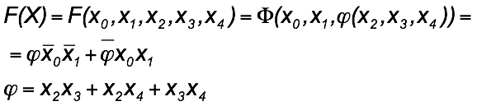
Decomposition: classic example of
nonstandard solution

Slide 22
Drawbacks
  Sometimes specific regularities but not the math complexity are dominate
  What kinds of regularities individuals are able to recognize?
  How these regularities are connected with known theoretical results of Digital Systems Design?
  Are there any correlation between solving different types of problems for the same functions?

Slide 23
SC and MM complexity measure
Vigo (2009), developed an alternative theory for calculating the complexity measure of a Boolean concept, defined as SC-Structural Complexity
The theory is based on a Boolean derivative
MM-Mental Model complexity theory (Johnson-Laird, 2006)

Slide 24
Our study
One and the same set of Boolean functions was examined for solving problems of: a) Recognition, b) Reconstruction and c) Fault Identification problems
Research population: Bachelor of Engineering students finished the introductory “Digital Logic Systems” course
Complex Boolean functions were used
An impact of symmetry, symmetry and monotony, symmetry and linearity property on the cognitive complexity was examined

Slide 25

Recognition
The recognition problems: formulating visual representation of Boolean concepts by using formula and/or verbally
Solving of the recognition problem - recognizing a Boolean function represented visually
The recognition problems is a “parallel” task

Slide 26
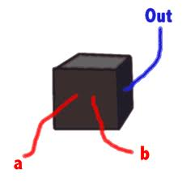
Reconstruction-RC
Reconstruction (RC) – recognizing the function implemented by a “black box”
RC is differ form the reverse engineering problem, which is reconstructing the scheme implemented within the “black box”
RC is a “sequential” task

Slide 27
Fault Identification Problems
Diagnosing failures is a ubiquitous activity both for engineers and citizens
Diagnosing failures is a type of problems, which solving is studied both in computer science and psychology
Faults effects correspond to a specific fault model that defines the new functioning of the circuit after the occurrence of the fault

Slide 28
Method and Experiments
The research population includes 60 first year students Bachelor of Engineering
All students studied the Digital Systems Design course in the same group and with the same lecturer
Experiments were conducted for 13 Boolean functions

Slide 29
Recognition. Experimental study
Recognition problem solving was examined using a questionnaire including 13 patterns
The participants were asked to describe each of the patterns in the shortest form
The above experiments were conducted in two days

Slide 30
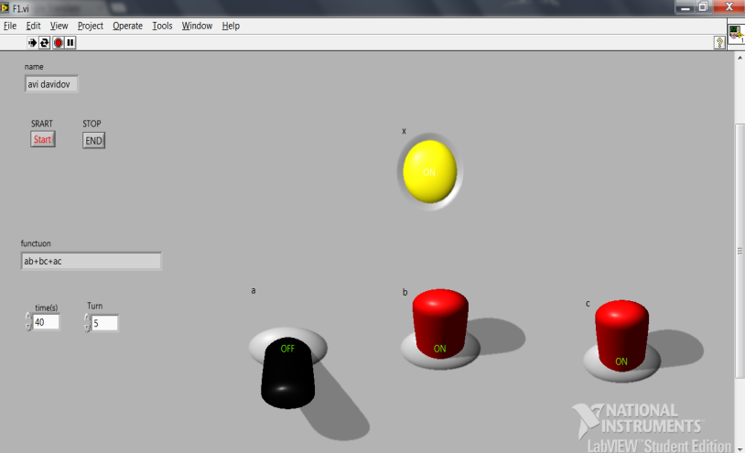
Reconstruction. Experimental study
An experimental Lab View environment is used
The state of the switches can be changed by users
According to the switches state, the light is either on or off
The participants were proposed to reconstruct the Boolean function that turns the light on

Slide 31
Fault identification. Experimental study
Fault identification problems were examined using a questionnaire where ten digital circuits realized Pseudo-NMOS technology
The experiment was conducted in three stages (A, B, C)
        For each circuit participants were asked to formulate the function of the circuit
        The participants received a function that the circuit implements as a result of a short fault and were asked to discover the location of the fault
        The participants received a function that the circuit implements as a result of a stuck-open fault and were asked to discover the location of the fault

Slide 32
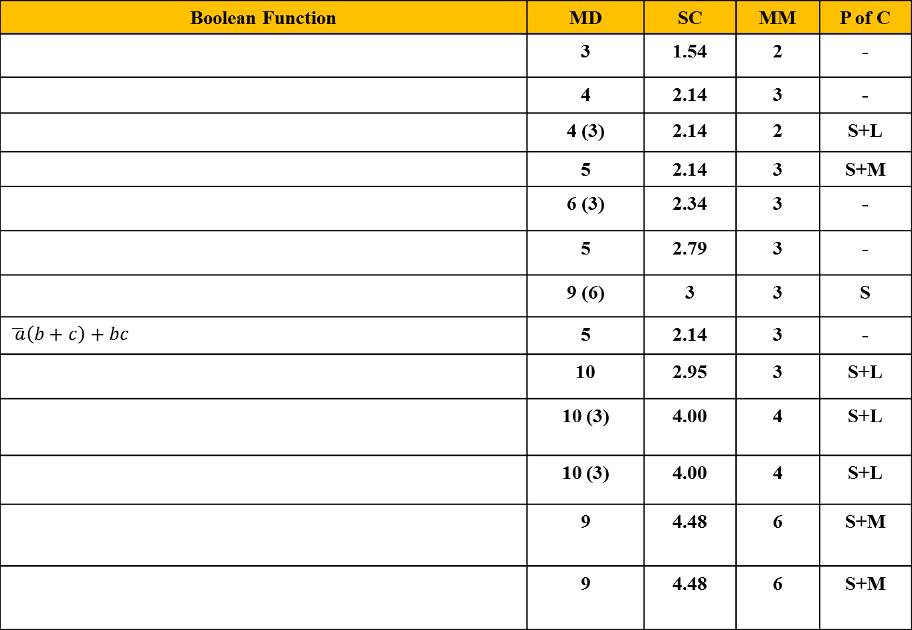


Functions that were examined
Boolean Function | MD | SC | MM | P of C
 | 3 | 1.54 | 2 | -
 | 4 | 2.14 | 3 | -
 | 4 (3) | 2.14 | 2 | S+L
 | 5 | 2.14 | 3 | S+M
 | 6 (3) | 2.34 | 3 | -
 | 5 | 2.79 | 3 | -
 | 9 (6) | 3 | 3 | S
$$\overline{ a}\left(b+c\right)+bc$$ | 5 | 2.14 | 3 | -
 | 10 | 2.95 | 3 | S+L
 | 10 (3) | 4.00 | 4 | S+L
 | 10 (3) | 4.00 | 4 | S+L
 | 9 | 4.48 | 6 | S+M
 | 9 | 4.48 | 6 | S+M
$$a\left(b+c\right)+bc$$
$$\left(\overline{a}+\overline{b}\right)\overline{c}+abc=\overline{c⊕\left(ab\right)}$$

Slide 33
Results
N | RE problems |  |  | Recognition problems Accuracy (%) | Fault problems
 | Accur. (%) | av. time (sec) | av. tests |  | Accuracy (%) Stuck-open | Accuracy (%) Bridging
1 | 100 | 97.93 | 7.51 | 84 | 100 | 90
2 | 89 | 136.25 | 10.49 | 74 | 89 | 77
3(S+L) | 95 | 97.35 | 7.72 | 89 | 63 | 58
4(S+M) | 100 | 58.53 | 5.85 | 98 | 100 | 93
5 | 79 | 169.62 | 12.74 | 63 | 61 | 48
6 | 76 | 190.45 | 13.11 | 59 | 72, 83 | -
7(S) | 99 | 102.44 | 8.55 | 94 | 100 | 98
8 | 86 | 201.50 | 12.30 | 73 | 100 | 46
9(S+L) | 79 | 253.21 | 18.51 | 68 | 98 | 85
10(S+L) | 59 | 218.08 | 15.79 | 50 | 34 | 27
11(S+L) | 64 | 201.51 | 13.14 | 56 | 38 | 26
12(S+M) | 94 | 152.31 | 12.96 | 78 | 99 | 97
13(S+M) | 89 | 170.70 | 14.06 | 70 | 99 | 97

Slide 34
Conclusions
There is no direct correspondence between success in solving the three types of problems for the same functions
Participants that recognized “xor”, were more successful in solving all three types of problems
70% of participants did not recognize the “xor” operator in any of three types of problems
                In general, the participants were much more successful in solving RC problems than in solving the recognition and faults identification problems
                There were no participants that failed in solving the RC problems, but, on the same time, successfully solved the recognition problems for the same functions. Some of the participants that managed to solve RC problems are failed in solving the recognition problems
                The symmetry and monotony property was successfully recognized by the majority of the participants
                All the complexity measures that we relied on failed to predict the difficulty in solving reconstruction problems.

Slide 35
Among the symmetric functions that were tested, the “xor” operator was more complex to solve in the two types of problems compared to other symmetric concepts that were examined
Monotonic and symmetrical concepts are the easiest solution.
The structural complexity (SC) measures better predictor compared to the minimal description (MD) and Mental Model (MM), except concepts with properties of symmetry, linearity and monotonicity.

Slide 36
Further research
To test the same group of participants for the faults identification and reconstruction for sequential logic circuits
To examine results not only on the base of “correct / incorrect” students’ answer but on the base on deeper analysis
To study how such properties of Boolean functions as linearity and monotony affect the cognitive complexity of Boolean concepts

